Slide 1
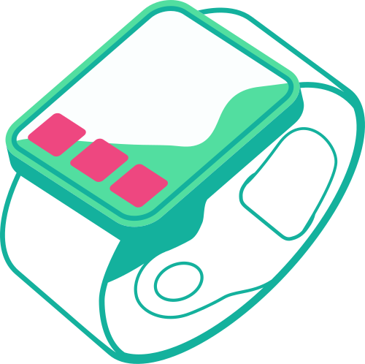


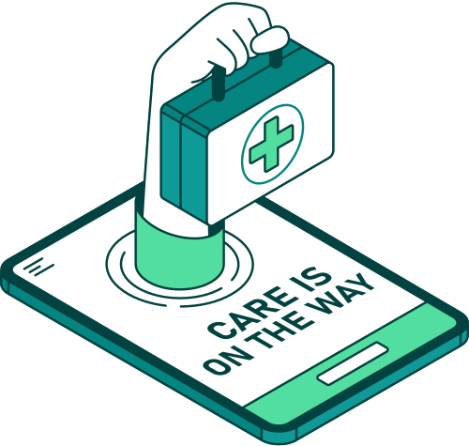
IOT-BASED SEIZURE DETECTION AND RESPONSE WEARABLE
Healthcare Industry- Seizure Detection/Prevention
Team connectivity
Manmayee rao-SM22UBBD061
Bhuvisha reddy-SM22UBBD017
Karthik kalva-SM22UBBD042
Saketh challa-SM22UBBD175
Bhashi chaganti-SM22UBBD022

Slide 2

ABOUT THE INDUSTRY
The Internet of Things (IoT) industry is revolutionizing healthcare by enabling real-time monitoring, data-driven insights, and proactive responses. In the context of epilepsy management, IoT technologies offer transformative solutions to enhance patient safety and quality of life. IoT-enabled devices like smartwatches and EEG headbands provide real-time monitoring of brain activity and vital signs, enabling early seizure detection. These devices can send instant alerts to caregivers and healthcare providers, ensuring timely intervention. IoT systems also gather and analyze data to identify seizure patterns and triggers, supporting personalized treatment.

Slide 3

MOTIVATION TO PURSUE THE INDUSTRY
This project focuses on meeting the essential needs of people living with epilepsy:
EARLY SEIZURE DETECTION:
REAL-TIME ALERTS:
LOMG-TERM TRACKING:
Seizures can happen without warning, putting patients at risk.
The device detects seizures early, allowing for quick action and reducing the risk of harm.
Patients can’t always alert others during a seizure, and family may not be nearby. Instant alerts ensure caregivers and emergency services respond quickly, offering peace of mind.
Tracking seizures over time is vital for adjusting treatments and improving care. The device monitors patterns and progress, helping doctors fine-tune treatments for better outcomes.

Slide 4

IDEATION PHASE
CHALLENGES IDENTIFIED
Unnoticed seizures leading to emergencies.
Lack of real-time communication between patients and caregivers.
Difficulty in identifying long-term seizure triggers.

Slide 5
IDEATION PHASE
SHORTLISTED OPPORTUNITIES
Early Detection Using EEG and PPG Sensors:
Sensors monitor brain and physiological activity to detect seizures early, enabling timely intervention.
Real-Time Response via IoT-Based Alerts:
IoT alerts notify caregivers and emergency services instantly during seizures, ensuring quick assistance.
Long-Term Data Tracking for Personalized Care:
Continuous data tracking helps analyze trends, identify triggers, and tailor treatments for better outcomes.

Slide 6




SHAMROCK DIAGRAM
USERS:
Patients (end-users of the device).
Caregivers (receive alerts).
Doctors (analyze collected health data)
Focus: Personalization, health tracking, and user-centric design.
ENTERPRISES:
Hospital systems (integration with processes).
Emergency services (real-time alerts).
Insurance companies (leveraging health data for policy personalization).
Focus: Process efficiency and operational alignment.
THINGS:
Sensors (detect seizures and health parameters).
Communication modules (e.g., Bluetooth, NFC).
Cloud platforms (store and analyze data securely).
Focus: Robust hardware and seamless connectivity.
PARTNERS:
App developers (real-time alert platforms).
IoT vendors (smart devices, software).
Cloud providers (secure and scalable storage).
Focus: Value chain optimization and collaborative innovation.

Slide 7
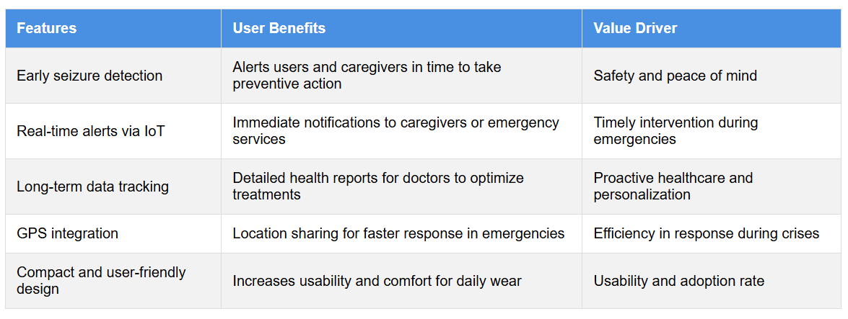
PREPARATION PHASE
In this phase, opportunity to make sure it aligns with our core goal: improving patient safety, providing peace of mind through real-time monitoring, and streamlining the overall healthcare experience for both patients and caregivers.
Demonstrate how each opportunity aligns with the user’s needs and create value.
VALUE DRIVER MAPPING

Slide 8
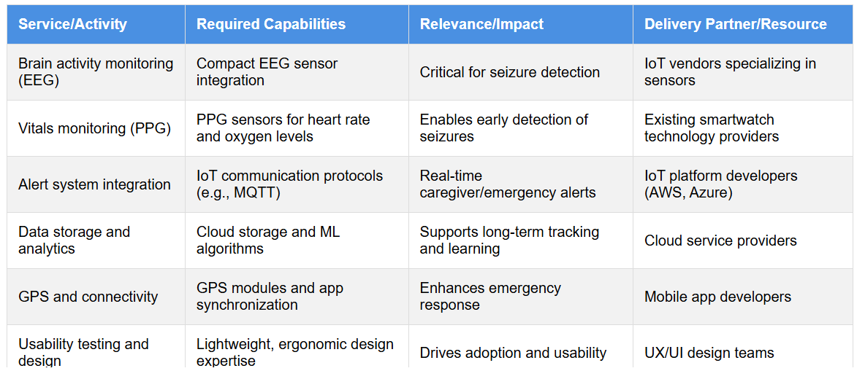
CAPABILITIES ASSESSMENT TABLE

Slide 9
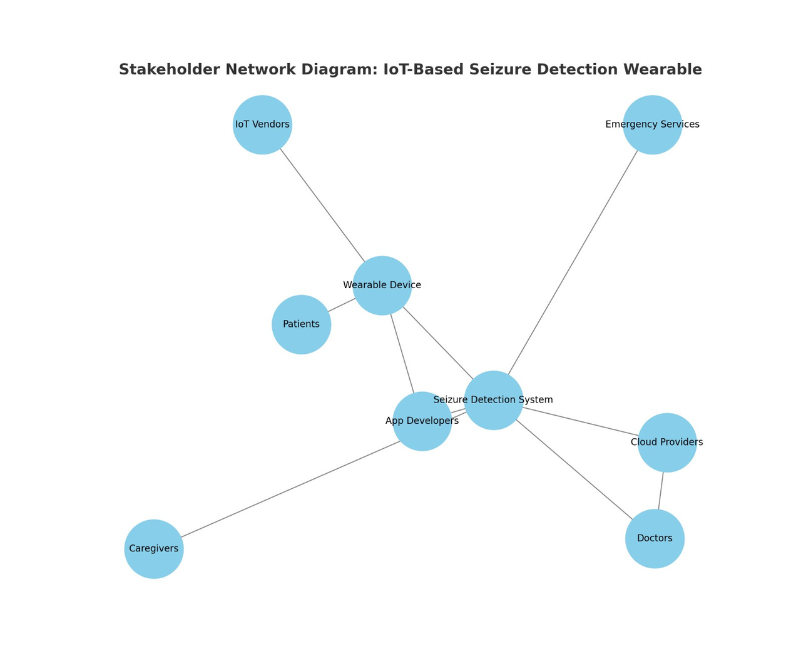
STAKEHOLDER NETWORK DIAGRAM
Primary Stakeholders:
Patients: End-users who rely on the wearable for safety and health monitoring.
Caregivers: Receive alerts and provide immediate support during seizures.
Doctors: Use data to optimize treatment plans and monitor progress.
Secondary Stakeholders:
IoT Vendors: Provide sensors, communication modules, and other hardware.
App Developers: Build the companion app for real-time alerts and data tracking.
Emergency Services: Respond promptly using GPS location data.
Cloud Storage Providers: Store and analyze patient data securely.

Slide 10
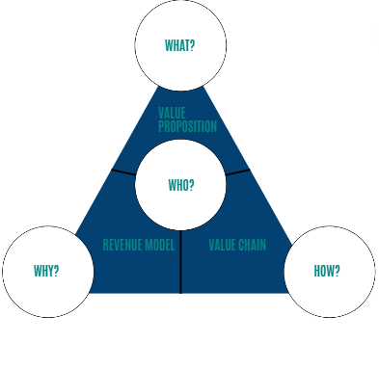
ST.GALLEN’S MAGIC TRIANGLE
WHO:
Target users: Patients with epilepsy, caregivers, and healthcare providers.
Secondary stakeholders: Emergency services, tech vendors, and app developers.
What do we offer?
IoT wearable for seizure detection, alerts, and tracking.
WHAT:
IoT wearable for seizure detection, real-time alerts, and long-term tracking.
Offers subscriptions for premium analytics and data storage.
Who is the primary customer segment?
Patients with epilepsy, caregivers, and health providers.
What are our revenue sources for the business?
Subscription for premium analytics and premium storage.
HOW:
Leverages IoT sensors, cloud analytics, GPS, and a companion app.
Provides seamless integration with healthcare ecosystems.
VALUE:
Safety, timely response, and peace of mind for users and their families.
Improves healthcare outcomes and empowers patients.
How do we deliver the produced value?
IoT sensors, GPS, and seamless healthcare integration.

Slide 11
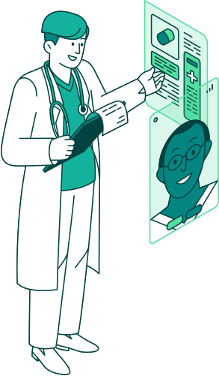

EVALUATION PHASE
System Testing: Evaluating the effectiveness of seizure detection and the timeliness of alerts.
User Feedback: Collecting feedback from patients, caregivers, and healthcare professionals on the system's functionality.
Scenario Planning: Assessing the system's scalability, affordability, and potential integration into existing healthcare infrastructure.
Impact Assessment: Measuring the impact on patient care, emergency response times, and overall effectiveness.
Iteration & Improvement: Using the insights from feedback and testing to refine and enhance the solution.

Slide 12
REFERENCES
https://ieeexplore.ieee.org/document/10128719 https://pmc.ncbi.nlm.nih.gov/articles/PMC11047798/ https://pmc.ncbi.nlm.nih.gov/articles/PMC9213709/
https://link.springer.com/chapter/10.1007/978-3-031-22356-3_22
https://www.tenovi.com/wearable-devices-for-epilepsy/
https://onlinelibrary.wiley.com/doi/10.1155/2017/6043069
https://link.springer.com/article/10.1007/s10462-024-10799-y
https://journaljamcs.com/index.php/JAMCS/article/view/1938
https://pmc.ncbi.nlm.nih.gov/articles/PMC11461032/
https://onlinelibrary.wiley.com/doi/10.1155/2017/6043069
https://www.sciencedirect.com/science/article/pii/S1388245720306143

Slide 13

THANK YOU

